Slide 1


Pulse+
Satya Yoganand Addala
ID:2086008
Class: hci 440

Slide 2
Description
Assignment – Currently it helps to review the grades and scores and notify about due dates
Although this integrated experience provides us to launch course homepage option my application will provide a single time login for all the courses and provides with an interface of all the available options which are present in D2L
Common use cases involve notifying a user on the due date and the other is notifying the user when grades get updated.
This integrated experience available called ”Pulse”. But pulse+ application will improve upon or extend the experience like helps user to complete some small assignments like quiz’s and provides to participate in discussion posts.

Slide 3
Description
Uses can get benefited by using this app as they don’t have to login to D2L each time for completing small quizzes and reading the discussion posts.
In Pulse , we don’t see this option as it has been used only to check Grades. Although it provides a web-based usage and Pulse + will provide a handy application with familiar Ui Experience as well.

Slide 4
Affordances
Sensory affordance – Enable user in sensing
1) Seeing the Quiz’s is a kind of sensory affordance.
2) Verifying the Grade Status.
3) Later on, you can view the deadlines and questions on Discussion forms.
Cognitive affordance – Enable user to thinking, learning, understanding and knowing about the things
1) Using the app and trying to understand the learn the things for new users.
2) Users have multiple options to explore like doing assignments , quizzes and viewing on discussion forms.
3) Verifying the Updated grades in the notifications tab.

Slide 5
Affordances
Physical affordance – Enable user to do something physically
1) Select the pending Assignment’s option to view the upcoming quiz’s
2) View the grades by selecting the Grades option
3) Select the discussion forms option to participate in a discussion.
Functional affordance – Enable user to use tools
1) Installing an Application
2) The Users will use mobile screen to make actions on clicking buttons

Slide 6
Users
User 1 : Student Login
Here is the user 1. Students can easily access the course details much more easier than accessing the current webpage via laptop/computer.
Since there is an inbuilt notification on due dates the user can easily check the upcoming events and he can complete the task if he has less time or if he is in transit.

Slide 7
Users
User 2 : Tutor Login.
Here is the user 2. These Users generally refers to professors in which the tutors will have their admin access to manage the due dates and can also update any assignments.
There will be an inbuilt notification for discussion forms to access directly from where ever they are.

Slide 8
Scenarios 1
Before application
Here is the student called Emma. She is a student at DePaul university to complete her Master’s Degree in Computer Science. She had spent 6 months at the University and she had to visit her home due to some emergency and she forgot her laptop to bring to home and there is a quiz deadline with in 2 days and if we consider that she hasn’t got any extended deadline , she wanted to complete the quiz in time and she is searching for an application to do so.
Although she had a pulse Application she can only view the due dates.

Slide 9
Scenarios 2
While using application
Then one of his friends suggest my application to complete the assignment. Then Emma installed my application and with in no time she completed the Quiz and her grade has been updated. she felt happy with the application and finds it very useful.

Slide 10
Scenarios 3
After using application :
One day Emma meets her friend, Then she asks Emma about application. Then Emma with his happy face tells that. It is pretty and very helpful. Now she can easily complete the assignments in time no matter where he is. When ever she want, she can keep track of the due dates and submit her quizzes in time.
After using this application. I suggested my friends to use this app. Even they are happy that application.

Slide 11

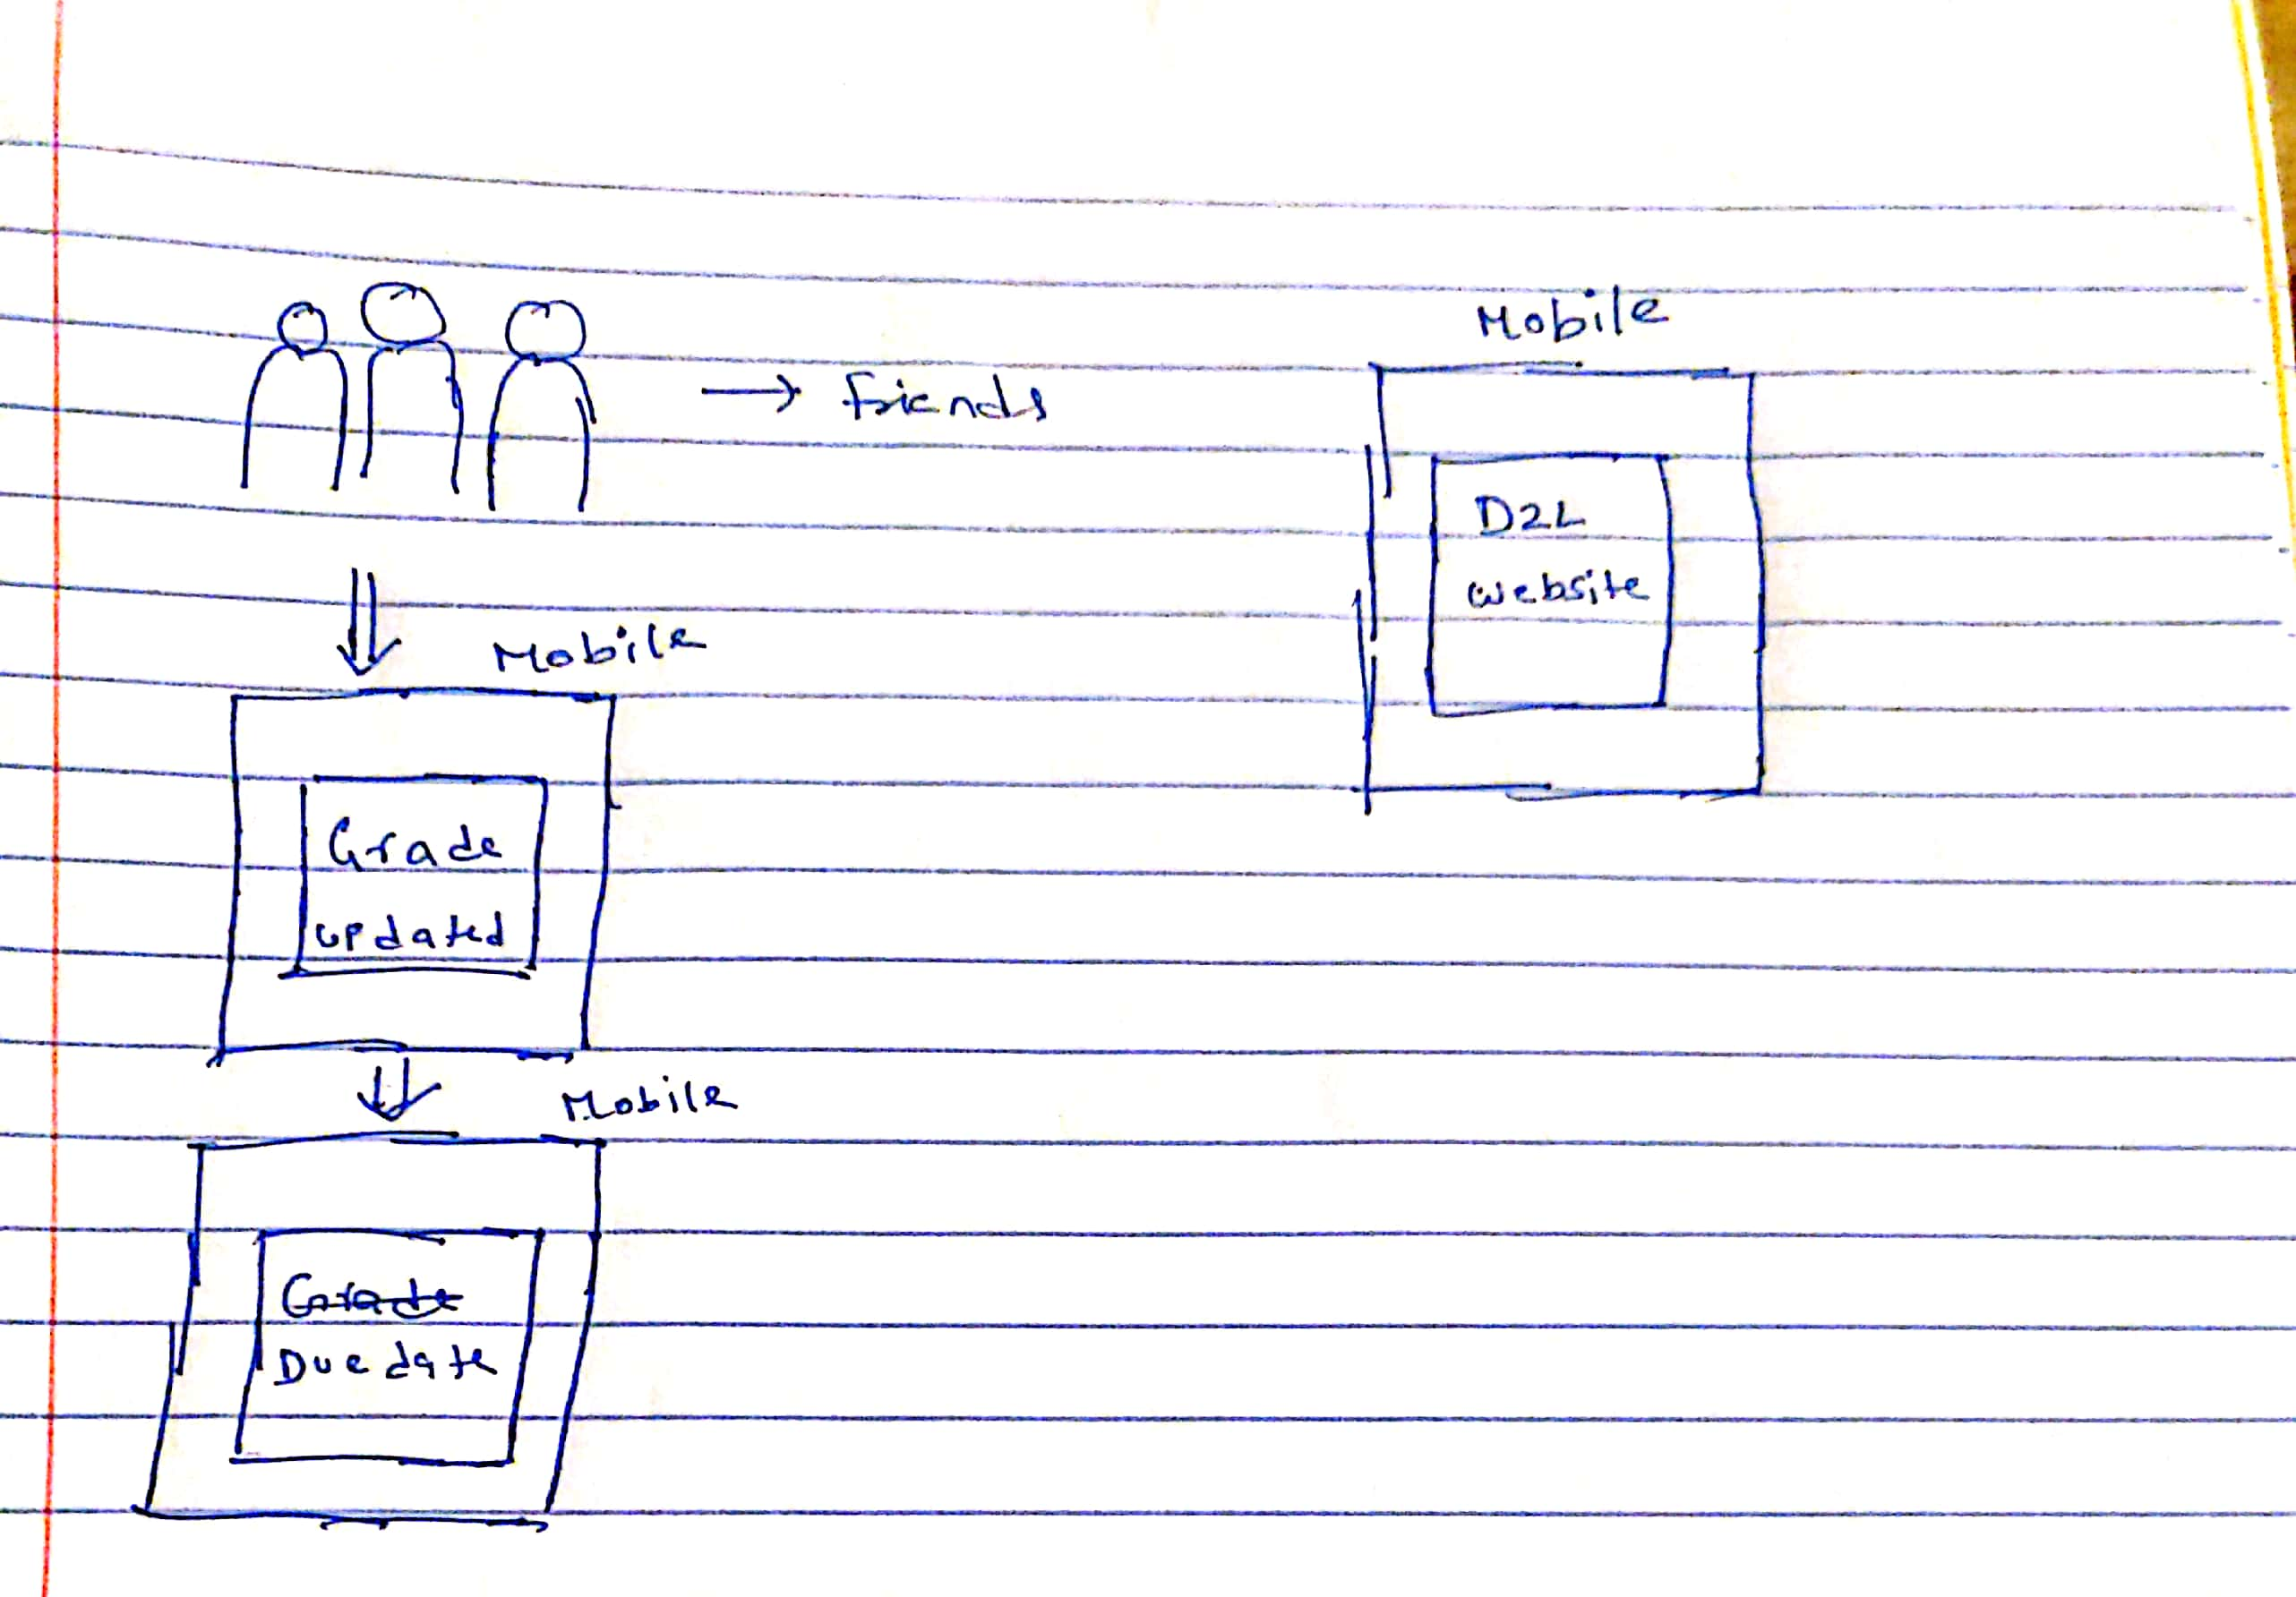



Sketches (Before)

Slide 12
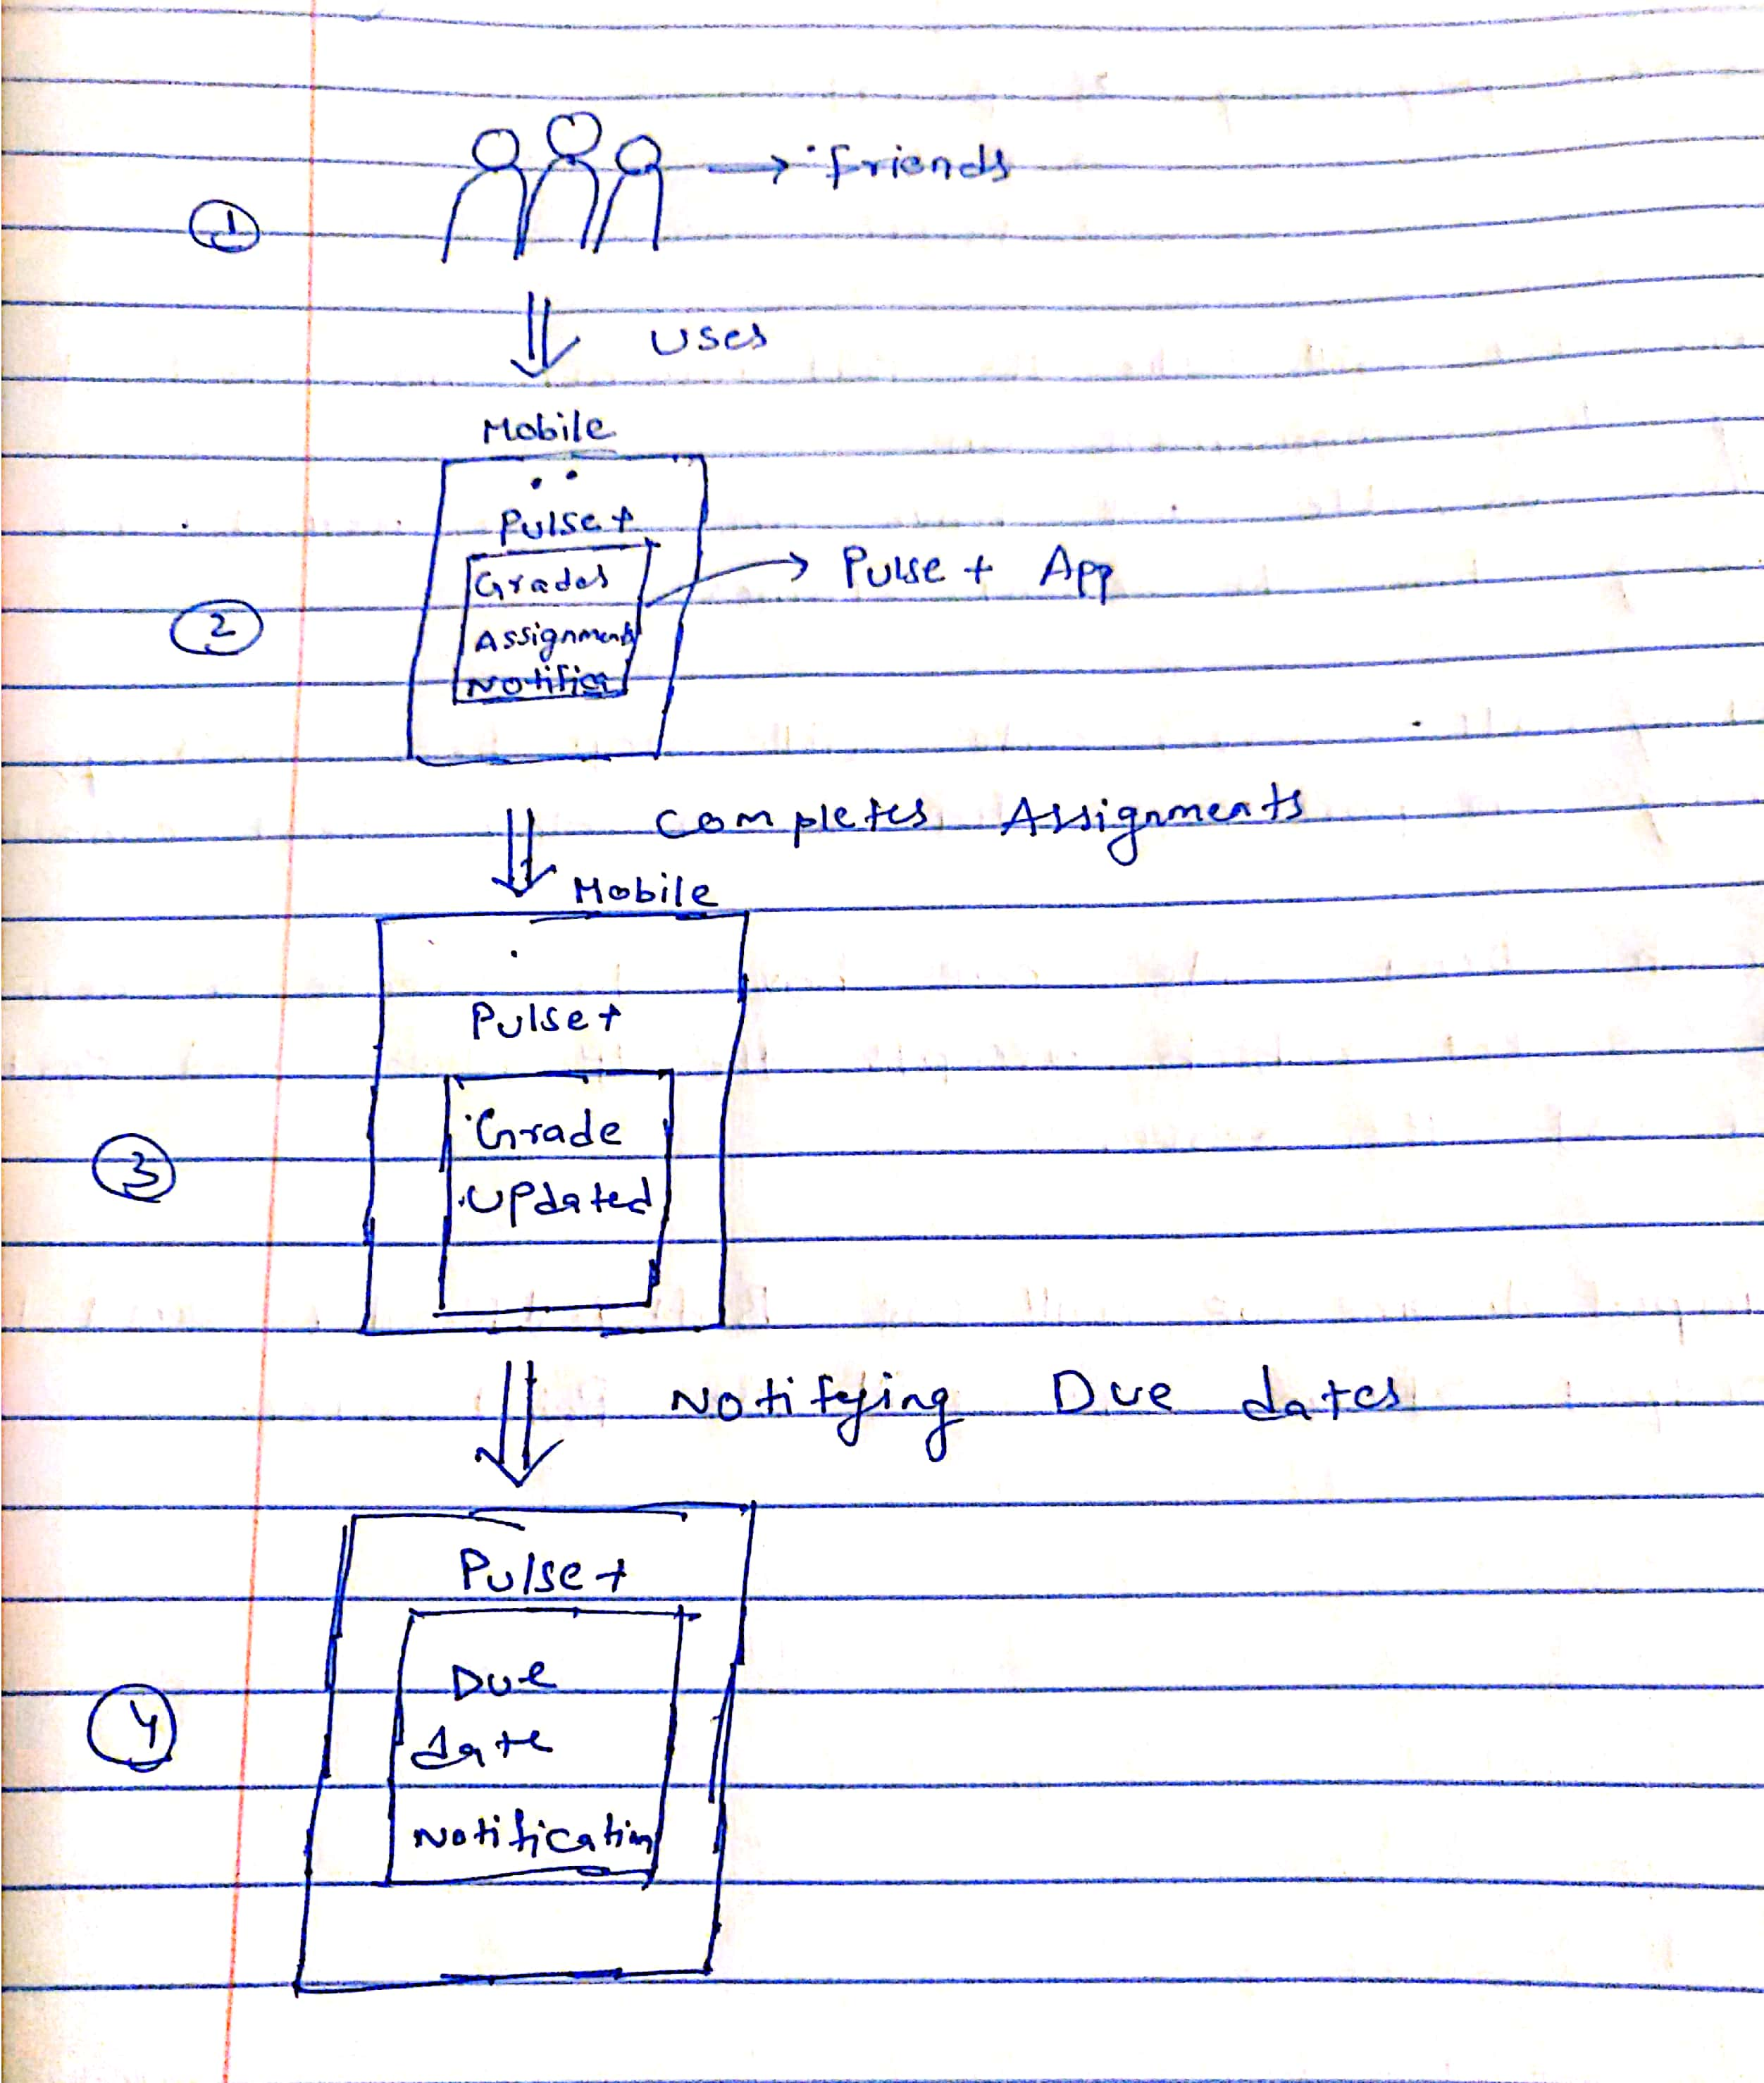
Sketches (After)

Slide 13
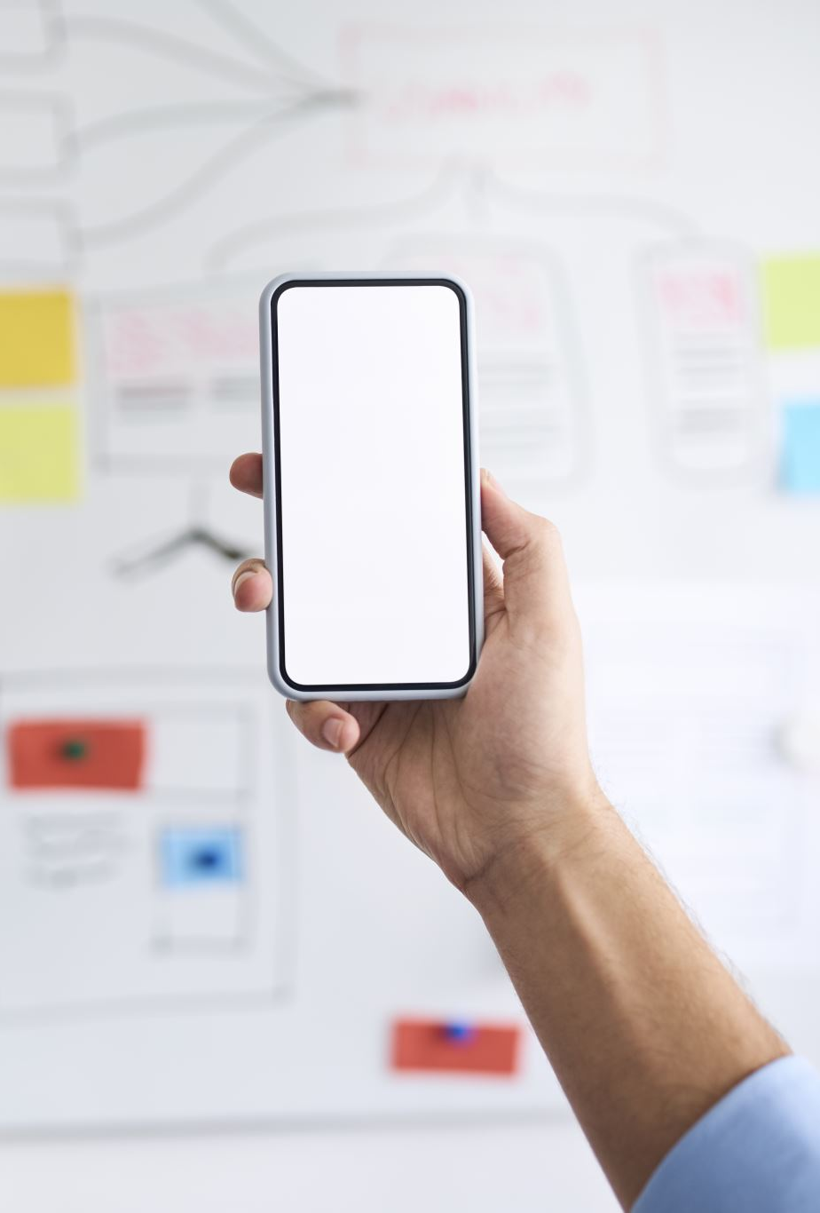
Potential problems
There might be potential app crashes due to virus from any third party software applications
To over come his problem, make sure that no third party applications are installed
It can also be avoided if we have a good protection apps for the mobile.
There might be Data Breaches
To overcome this we can enable dual authentication for the Application.

Slide 14
Insights
Idea : Ideas will build the things, plays important role.
Affordance : Object that defines its possible users or makes clear
Users : It shows how many possible ways that, we can build an application
Scenarios/sketches : It is best way to understand application by story telling or by seeing sketches
Potential problem : By this we can say, what are the problems that users can face while using application

Slide 15
Additional Interactive Experience Ideas
Restaurant QR Application
Although there is a direct scanning of QR using Google lens to retrieve the information we can create an interaction application to include all the restaurants nearby and can add all the available items to the cart and check it out. Also the payment through credit/debit is an add-on to the Application.

Slide 16

Additional Interactive Experience Ideas
Crypto Currency Exchange
We can Create an application where currently there are some applications where the currency can be exchanged in between different users but from my application we can directly connect with the users bank account to link to the account and ask them to convert his currency and release some funds.
This is it will be more beneficial to users because the currency exchange rate is quite his when compared to that of bank’s. So it is a very good interactive Idea to implement.

Slide 17
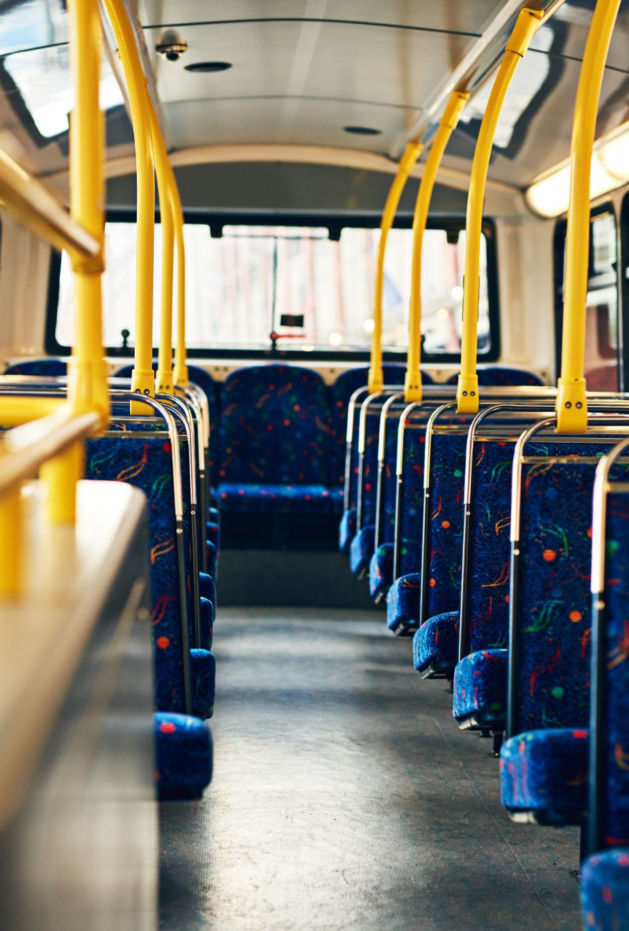
Additional Interactive Experience Ideas
Ventra Mobile Application
This Application is for Chicago transport where it currently provides users to travel to CTA busses and trains. This application can be updated for getting favorite bus notifications and some of the busses doesn’t show the accurate time to reach the station. We can also fix that.

Slide 18

Additional Interactive Ideas
Instant File Transfer
Users Can transfer their files with the nearby users through the application where there is no limit for the size of data and there is also an additional QR Code Scanner to scan from other users we can share some music playlists as well.

Slide 19

Additional Interactive Ideas
Interactive mobile Library events
You can find events such as collecting books in exchange of submitting a book which you have already gone through. By this you gain the knowledge and you can meet so many people with similar ideas.

Slide 20


